Slide 1
Agricultural Yield & Farmer Advisory
A CRISP-DM decision-support project
Presentation for a non-technical stakeholder team
Understand
What patterns are associated with yield?
Predict
Can later observations be grouped as Low, Medium or High yield?
Route questions
Can farmer questions be organized by crop?

Slide 2
1. Business Understanding
The decision we are trying to support
Problem statement
Agricultural extension and planning teams need a clearer evidence base for understanding where yield patterns vary and where further investigation or support may be needed. Historical agricultural data can be used to examine relationships among rainfall, temperature, pesticide use, crop and area, while a prediction layer can flag later observations by relative yield band.
The goal is decision support — not automatic farm management.
Use evidence to identify patterns, flag observations for attention, and organize farmer questions by crop.
Human agricultural expertise remains responsible for interpreting evidence and deciding action.
Agricultural Yield & Farmer Advisory • CRISP-DM

Slide 3
2. Data Understanding
What information is available?
Structured yield data
The documentation reports a published merged dataset of 25,932 rows and 7 columns. The notebook demonstration used a 1,800-row demo subset.
Fields include area, year, rainfall, pesticide use, average temperature, crop and yield.
FarmerChat text data
The documentation reports 42,709 Q&A pairs overall, including 6,815 from Kenya. The notebook demonstration used 1,500 Kenya demo records.
The main text field is the farmer query; crop is the historical label.
Important data connection
The two sources share agricultural concepts such as crop and geography, but they are not linked row-by-row by an individual farm ID. They are therefore treated as separate phases within the same agricultural domain.
Agricultural Yield & Farmer Advisory • CRISP-DM

Slide 4
3. Data Preparation
Making the information usable and fair for analysis
Standardized field names and converted numeric fields to the correct format.
Checked missing values and duplicate rows; the demo yield data had 0 duplicates and no missing values.
Removed records without the yield outcome and treated impossible negative rainfall, pesticide or yield values as invalid.
For prediction, yield was converted into three relative bands: Low, Medium and High.
The yield-band thresholds were calculated from training data only, helping prevent future information from leaking into model training.
Later years were held back for testing rather than randomly mixing past and future observations.
Agricultural Yield & Farmer Advisory • CRISP-DM

Slide 5
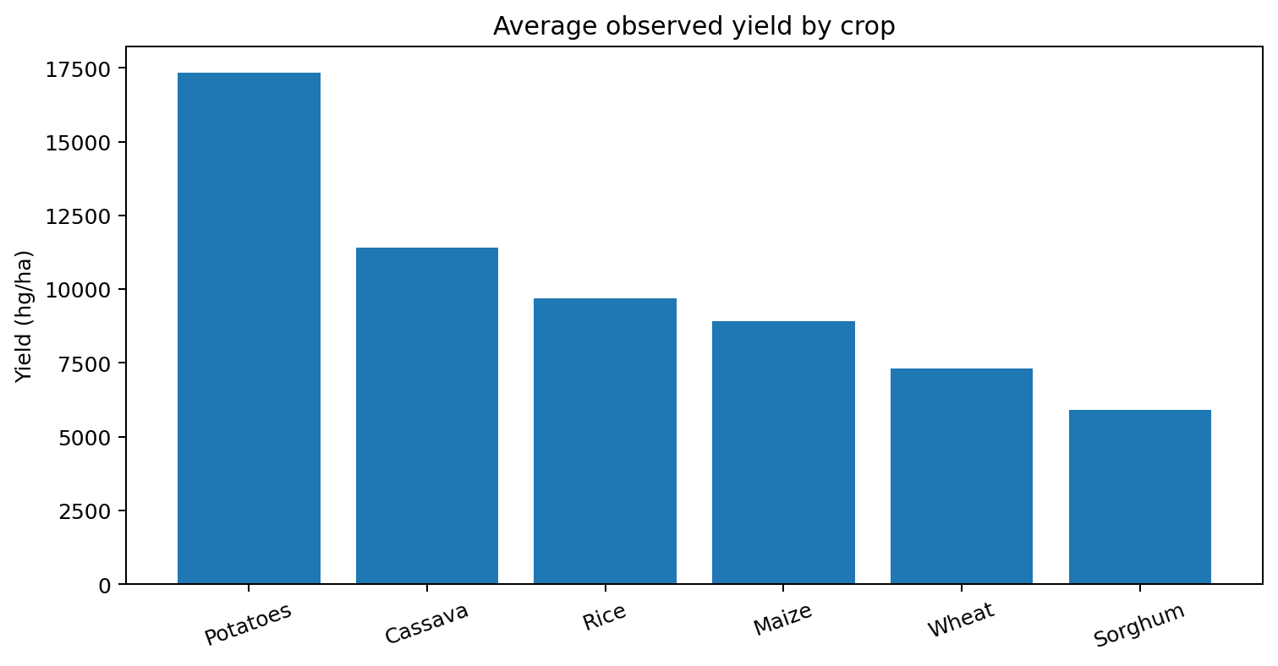
4. Exploratory Analysis
What does the demonstration data show?
Clear crop differences
Average observed yield varied substantially across the six crops in the demo data.
Highest in demo
Potatoes: 17,349 hg/ha average
Sorghum: 5,908 hg/ha average
Interpret carefully
These are observed differences, not proof that crop type alone causes the yield difference.
Phase 1 • Demo subset results from the executed notebook

Slide 6
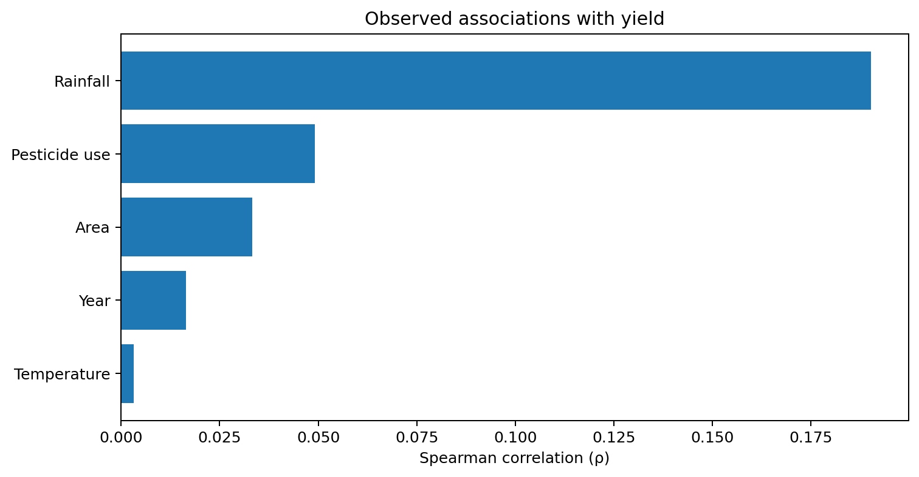
4. Exploratory Analysis
Environmental variables: association, not causation
Rainfall showed the strongest association
Spearman ρ = 0.1903 in the demo data. The relationship is positive but modest.
Pesticide use
Spearman ρ = 0.0492. This is a much weaker observed association.
What this means
The analysis identifies relationships worth investigating; it does not establish cause and effect.
Phase 1 • Spearman results from the executed notebook

Slide 7
4. Exploratory Analysis
Statistical checks strengthen the evidence
Spearman correlation
Used to test whether numeric variables move consistently with yield. In the demo, rainfall had ρ=0.1903 and p<0.001; pesticide use had ρ=0.0492 and p=0.037.
Kruskal–Wallis test
Used to test whether yield distributions differ across crop groups. Demo result: H=1384.586, p≈3.01×10⁻²⁹⁷, indicating a statistical difference somewhere among the crop groups.
Stakeholder takeaway
Crop groups and some measured variables show patterns that deserve attention, but the data alone should not be used to claim that changing one factor will cause a specific yield outcome.
Agricultural Yield & Farmer Advisory • CRISP-DM

Slide 8
5. Modeling
Turning historical information into a practical flag
Inputs
Area • Year • Rainfall • Pesticide use • Average temperature • Crop
Prediction
Classify a later observation into a relative yield band:
LOW • MEDIUM • HIGH
Use
Flag observations for further investigation or planning — not automatic intervention.
Why test on later years?
The latest 20% of unique years were reserved as the test period, making the evaluation closer to the real question: can earlier information help classify later observations?
Agricultural Yield & Farmer Advisory • CRISP-DM

Slide 9
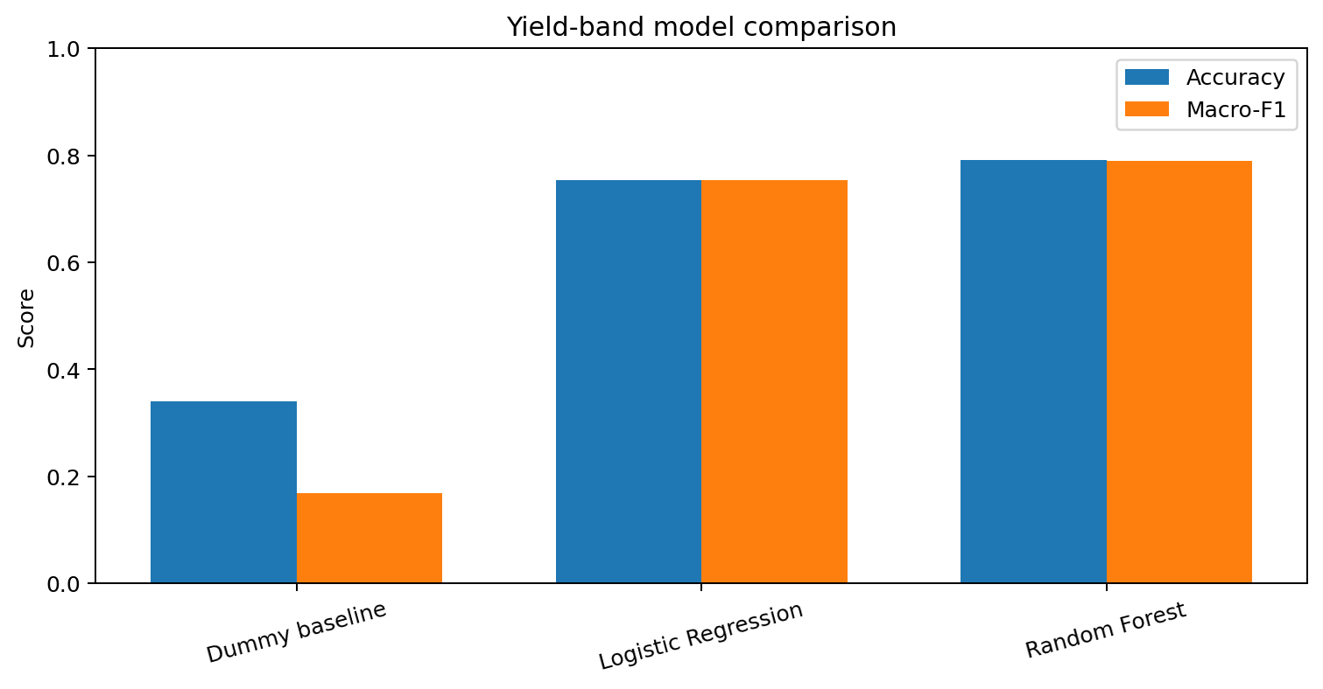
6. Evaluation
How well did the yield-band models perform?
Random Forest
Accuracy: 79.14%
Macro-F1: 78.94%
What errors remain?
Low: recall 82%
Medium: recall 71%
High: recall 83%
The Medium band was harder to classify.
Interpretation
The model is useful as a screening/flagging tool, subject to further validation.
Phase 2 • Held-out later-year demo results

Slide 10
5–6. Farmer Query Classification
Helping teams organize incoming questions
Step 1 — Read
A farmer submits a written question.
Step 2 — Classify
The text model identifies the crop category represented by the historical labels.
Step 3 — Route
The question can be directed or summarized for the relevant crop-focused workflow.
Demo result
The executed notebook achieved 100% accuracy and 100% macro-F1 on a 300-record stratified hold-out from the 1,500-record demo dataset.
Important boundary
This is a routing aid. It does not diagnose crop problems or generate agronomic treatment recommendations.
Agricultural Yield & Farmer Advisory • CRISP-DM

Slide 11
8. Conclusions & Limitations
What the team should take forward
What the project provides
• A structured CRISP-DM workflow
• Evidence on observed yield patterns
• A time-aware yield-band prediction approach
• A transparent farmer-query routing prototype
• Stakeholder-friendly dashboard and decision-support concepts
What it does not provide
• Causal proof that a factor changes yield
• Individual-farm longitudinal evidence
• Guaranteed future performance
• Automated agronomic diagnosis or treatment advice
Important next step
The supplied notebook demonstration uses demo subsets. The documentation states that the final full-data findings and model metrics should be generated by re-running the workflow on the full datasets before operational use.
Agricultural Yield & Farmer Advisory • CRISP-DM

